Slide 1
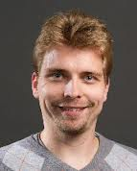

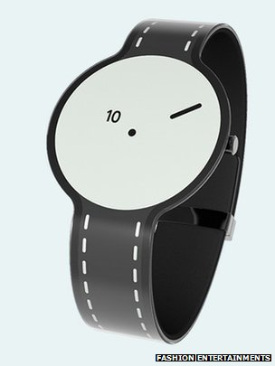
The Beauty and Joy of Computing Lecture #24
Future of Computing and YOUR Future
UC Berkeley EECS Lecturer Gerald Friedland
Sony makes experimental e-paper watch
Message: Tech industry goes fashion!
http://www.bbc.com/news/technology-30245296

Slide 2
Administrivia: Become active!
With-Snap! Exam details
No exam handed out unless you’ve filled in both HKN + our survey
No “study sheets” needed / allowed since you have access to Snap!
Final Exam details
Only bring pen{,cil}s, three 8.5”x11” handwritten sheets (writing on both sides).
Leave backpacks, books, calculators, cells & pagers home!
Everyone must take ALL of the final!
Bring your “Beauty and Joy of Computing” Art/Poem for extra credit!
If you did well in CS10 and want to be on staff?
Usual path: Lab Assistant  Reader  TA
Indicate on your final survey whether you’re even remotely interested
We strongly encourage anyone who gets an B or above in the class to follow this path…

Slide 3
Opportunities Next Semester
CS61A (1st course in CS major)
Structure and Interpretation of Computer Programs, Python
CS9 series (learn a second language)
I would recommend Python next, CS9H
GamesCrafters DeCal (Game Theory R & D)
Develop SW, analysis on 2-person games of no chance. (e.g., go, chess, connect-4, nim, etc.)
Req: Game Theory / SW Interest
MS-DOS X DeCal (Mac Student Developers)
Learn to program Macintoshes.
Req: Interest. Owning a mac helps, not required.
UCBUGG DeCal (Recreational Graphics)
Develop computer-generated images, animations.
Req: 3D interest

Slide 4
Ok, I’m hooked! Where do I go next?
CS Major / Minor
You are here
CS61A
In Python, one big idea every week. Awesome!
CS61B
In Java, data structures, algorithms and software engineering (lite)
CS61C
In C and MIPS, Great ideas in computer architecture (parallelism) … I teach this!
CS10
CS61A
CS61B
CS61C

Slide 5
Things to remember from CS10
Abstraction
The key idea underpinning all computer science
…and (in CS10) functions, HOFs
…From Blown to Bits
Technology has social implications (privacy, energy, copyright, etc); try to see the big picture
It also often has unintended consequences!
Things are never black or white, pure good or pure evil
…From “Program or Be Programmed”
Technology has an explicit and implicit agenda, understanding it is important.
Learning to program is empowering (Steve Jobs’ video)

Slide 6
Exciting Future Implications
In computing, chronic unsolved problem
Easy parallel programming
Implications for apps:
HUGE Computing power available in cell phone, car
On-body health monitoring
Google + library of congress
As devices shrink…
The need for great HCI (human-computer interfaces) critical as ever! (voice, gesture)
Natural language processing?
Interact by motion!
3D displays?
Personal Robotics?
Self-driving cars?
3D Printing?
Optical/quantum computing?
Personal air vehicle?
Space travel?
Computer displays in glasses?
Flexible displays?
Smart drones?
Energy!

Slide 7
Computer Technology - Growth!
Processor
Speed 2x / 2 years (since ’71)
100X performance last decade
When you graduate: 3 GHz, 32 Cores
Memory (DRAM)
Capacity: 2x / 2 years (since ’96)
64x size last decade.
When you graduate: 128 GibiBytes
Disk
Capacity: 2x / 1 year (since ’97)
250X size last decade.
When you graduate: 16 TeraBytes
Kilo (10³) & Kibi (2¹⁰)
⬇
Mega (10⁶) & Mebi (2²⁰)
⬇
Giga (10⁹) & Gibi (2³⁰)
⬇
Tera (10¹²) & Tebi (2⁴⁰)
⬇
Peta (10¹⁵) & Pebi (2⁵⁰)
⬇
Exa (10¹⁸) & Exbi (2⁶⁰)
⬇
Zetta (10²¹) & Zebi (2⁷⁰)
⬇
Yotta (10²⁴) & Yobi (2⁸⁰)

Slide 8
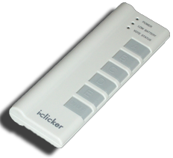
Peer Instruction
What was recently proposed to go after Yotta? (i.e., 10²⁷)
Lotta
Lotsa
Wholelotta
Hella
Zillion
Both Google’s and WolframAlpha’s calculator can understand and use “Hella” in their calculations!
www.makehellaofficial.blogspot.com

Slide 9
Kilo, Mega, Giga, Tera, Peta, Exa, Zetta, Yotta
Kid meets giant Texas people exercising zen-like yoga. – Rolf O
Kind men give ten percent extra, zestfully, youthfully. – Hava E
Kissing Mentors Gives Testy Persistent Extremists Zealous Youthfulness. – Gary M
Kindness means giving, teaching, permeating excess zeal yourself. – Hava E
Killing messengers gives terrible people exactly zero, yo
Kindergarten means giving teachers perfect examples (of) zeal (&) youth
Kissing mediocre girls/guys teaches people (to) expect zero (from) you
Kinky Mean Girls Teach Penis-Extending Zen Yoga
Kissing Mel Gibson, Teddy Pendergrass exclaimed: “Zesty, yo!” – Dan G
Kissing me gives ten percent extra zeal & youth! – Dan G (borrowing parts)

Slide 10
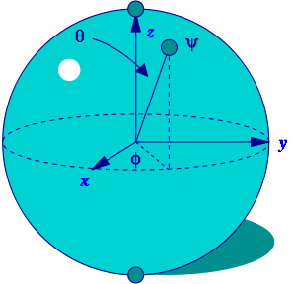
Quantum Computing (1)
Proposed computing device using quantum mechanics
This field in its infancy…
Normally: bits, which are either 0 or 1
Quantum: qubits, either 0, 1 or “quantum superposition” of these
This is the key idea
If you have 2 bits, they’re in exactly one of these:
00, 01, 10 or 11
If you have 2 qubits, they’re in ALL these states with varying probabilities
A Bloch sphere is the geometric representation of 1 qubit
en.wikipedia.org/wiki/Quantum_computer

Slide 11
Quantum Computing (2)
Imagine a problem with these four properties:
The only way to solve it is to guess answers repeatedly and check them,
There are n possible answers to check,
Every possible answer takes the same amount of time to check, and
There are no clues about which answers might be better: generating possibilities randomly is just as good as checking them in some special order.
…like trying to crack a password from an encrypted file
A normal computer
would take (in the worst case) n steps
A quantum computer
can solve the problem in steps proportional to √n
Why does this matter?

Slide 12
Quantum Computing (3)
Say the password is exactly 72 bits (0/1)
That’s 2⁷² possibilities
Let’s say our Mac lab attacked the problem
30 machines/lab * 8 cores/machine * 3 GHz (say 3 billion checks per second/core)
= 720,000,000,000 checks/sec/lab
= 720 Gchecks/sec/lab
Regular computers
2⁷² checks needed / 720 Gchecks/sec/lab
≈ 6.6 billion sec/lab
≈ 208 years/lab
72-qubit quantum computers in timeαto √2⁷² = 2³⁶
2³⁶ checks needed / 720 Gchecks/sec/lab
≈ 0.1 sec/lab

Slide 13

Quantum Computing Explained by Physicists
http://www.youtube.com/watch?v=T2DXrs0OpHUs

Slide 14
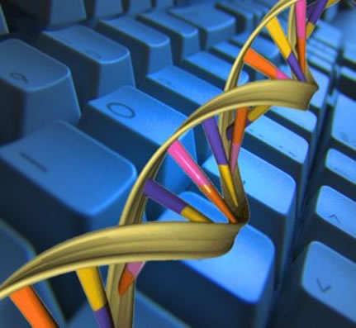
DNA Computing
Proposed computing device using DNA to do the work
Take advantage of the different molecules of DNA to try many possibilities at once
Ala parallel computing
Also in its infancy
In 2004, researchers claimed they built one
Paper in “Nature”
en.wikipedia.org/wiki/DNA_computing

Slide 15
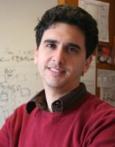
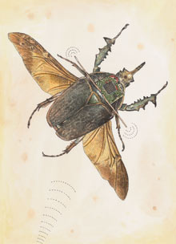
Biological Machines
www.eecs.berkeley.edu/~maharbiz/Cyborg.html
Michel Maharbiz and his team at Cal have wired insects (here a giant flower beetle) and can control flight
Implated as Pupa
Vision
Imagine devices that can collect, manipulate, store and act on info from environment

Slide 16
Peer Instruction
What is the most exciting future for computing?
Incremental improvements in computing architectures
Quantum computing
DNA computing
Biological Machines
Something completely different

Slide 17
Summary
What a wonderful time we live in; we’re far from done
What about privacy?
Find out the problem you want to solve
Computing can and will help us solve it
We probably can’t even imagine future software + hardware breakthroughs

Slide 18
The Future for Future Cal Alumni
What’s The Future?
New Millennium
Always-on internet connectivity + internet of things!
AI breakthroughs
HCI breakthroughs
Post-PC Era (power is in cloud, interface in pocket)
“The best way to predict the future is to invent it” – Alan Kay
The Future is up to you!

